Slide 1
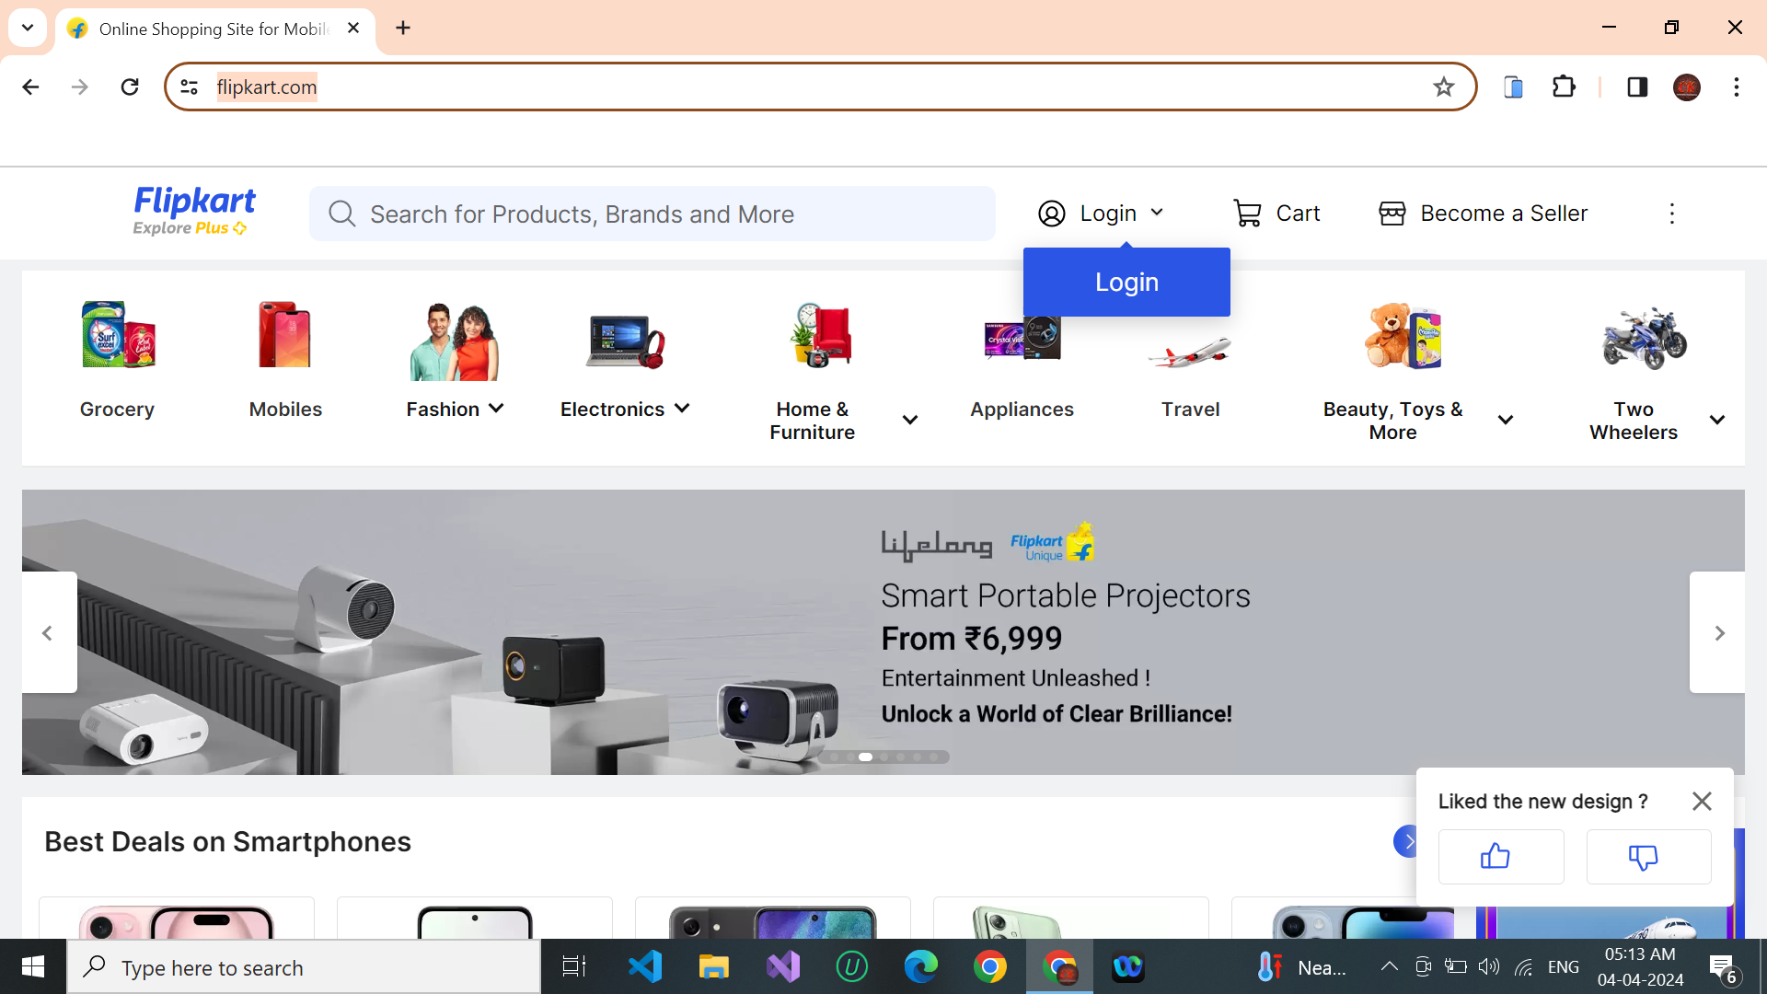
ASSIGNMENT 13
Flipkart : https://www.flipkart.com/

Slide 2
TEST PLANS :
OBJECTIVES:
Ensure that all key functionalities of the Flipkart website work as intended.
Identify and mitigate any potential issues or bugs in the system.
Validate the performance and reliability of the website under various conditions.
Verify that the website is user-friendly and provides a seamless shopping experience.
SCOPE:
The test scope covers the main functionalities of the Flipkart website, including user authentication, product search and navigation, shopping cart and checkout, payment processing, order management, and overall performance and compatibility.
It includes both frontend and backend testing to ensure end-to-end functionality.
METHODOLOGIES:
Black box testing: Focuses on testing the functionalities of the system without considering its internal structure or code.

Slide 3
Regression testing: Ensures that new changes or updates do not adversely affect existing functionalities.
User acceptance testing (UAT): Involves real users testing the system to validate whether it meets their requirements and expectations.
Performance testing: Evaluates the website's speed, responsiveness, and scalability under various load conditions.
Compatibility testing: Ensures that the website functions correctly across different browsers, devices, and operating systems.
TECHNIQUES:
Functional testing: Tests each function of the website to ensure it behaves according to specifications.
Boundary testing: Tests inputs at the boundary conditions to identify any unexpected behaviors.
Exploratory testing: Allows testers to explore the system freely to uncover defects that may not be covered by scripted tests.
Security testing: Identifies vulnerabilities in the system that could be exploited by malicious users.
Cross-browser testing: Ensures consistent behavior and appearance of the website across different web browsers.

Slide 4
ASSUMPTIONS:
The test environment simulates real-world conditions accurately.
Test data is representative of actual usage scenarios.
The website operates within its specified hardware and software requirements.
Third-party integrations such as payment gateways function correctly.
RISKS:
Potential risk of data breaches or security vulnerabilities, especially regarding user information and payment details.
Risk of performance degradation or downtime during high traffic periods, such as sales events or promotions.
Risk of compatibility issues across different devices, browsers, or operating systems.
Risk of user dissatisfaction due to poor usability or functionality issues.

